Slide 1
Truly Wireless Power Transfer
Andrew Wang & Dawinderdeep Sekhon
Professor Sotoudeh Hamedi-Hagh
April 15, 2023

Slide 2
Overview
Problem
Current standard for wireless charging (Qi) on mobile devices is based on induction of magnetic flux between Tx and Rx and requires small transmission distance (cm)
Qi requires precise physical alignment of phone and charger
Action
Explore feasibility of a truly wireless charging system
Build a prototype using resonance charging as an alternative to induction
Results
Proof of Concept that Resonance power transfer is possible at distances of over 1.5 ft.
Maintain Tx 1W/Rx 0.05W charging at 1.5 feet distance between phone and charger
Significance
Freedom and mobility for consumer, no need for precise alignment with the charger.
Eliminate batteries and cable chargers, reduce landfill waste
Notes:
in summary” , value proposition
A/D

Slide 3
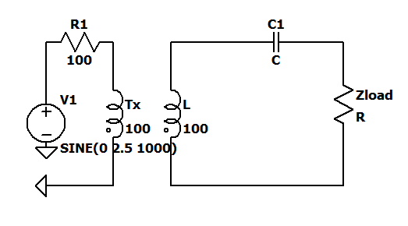
Equations
The B-fields from the Tx induce an alternating EMF in the small coil modeled as a voltage source.
The Rx captures the b-fields and induce an EMF, an equivalent alternating voltage source. The Rx also has self inductance which impedes the time-varying currents
The impedance of the Rx (L) is +jwL , choking current flow
The impedance of the C is -j/wC
If you adjust C so that +jwL -j/wC = 0 which is resonance,
The LC series will have zero impedance and the current driven by the B-fields in the coil will be unchoked
Notes:
. Xu, Y. Xu and Q. Zhang / Computers and Electrical Engineering 80 (2019) 106470

Slide 4
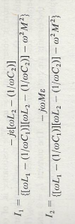
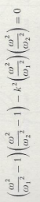
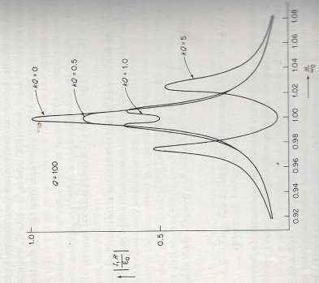
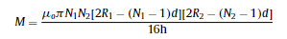
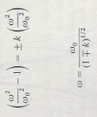
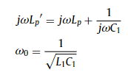
This is the formula to calculate resonance frequency
These formulas are used to calculate the current flowing through the Tx (I1) and Rx (I2). when the resonance conditions are met, the power on the receive side which is a function of current, (shown on the y axis of the graph) is maximized at the normalized resonance frequency, and tapers off as the inductive or capacitive inductance dominates and resonance conditions are not met.

Slide 5
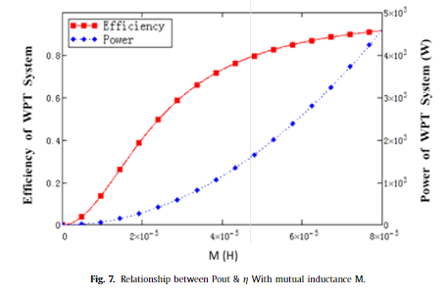
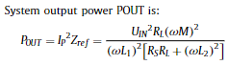
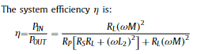
Equations
The Main functions of interest are of Power and efficiency which are detailed here
. Xu, Y. Xu and Q. Zhang / Computers and Electrical Engineering 80 (2019) 106470

Slide 6
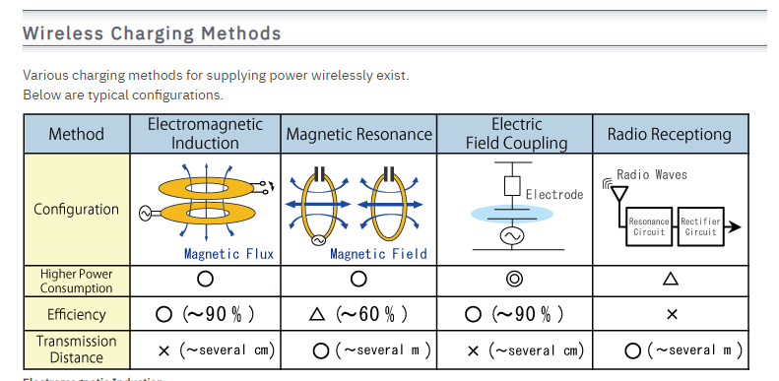
Field study
Source: https://www.rohm.com/electronics-basics/wireless-charging/wireless-charging-methods
The current method being used for wireless charging is Electromagnetic Induction
Magnetic Resonance is the method being used for this project.
Notes:
D

Slide 7
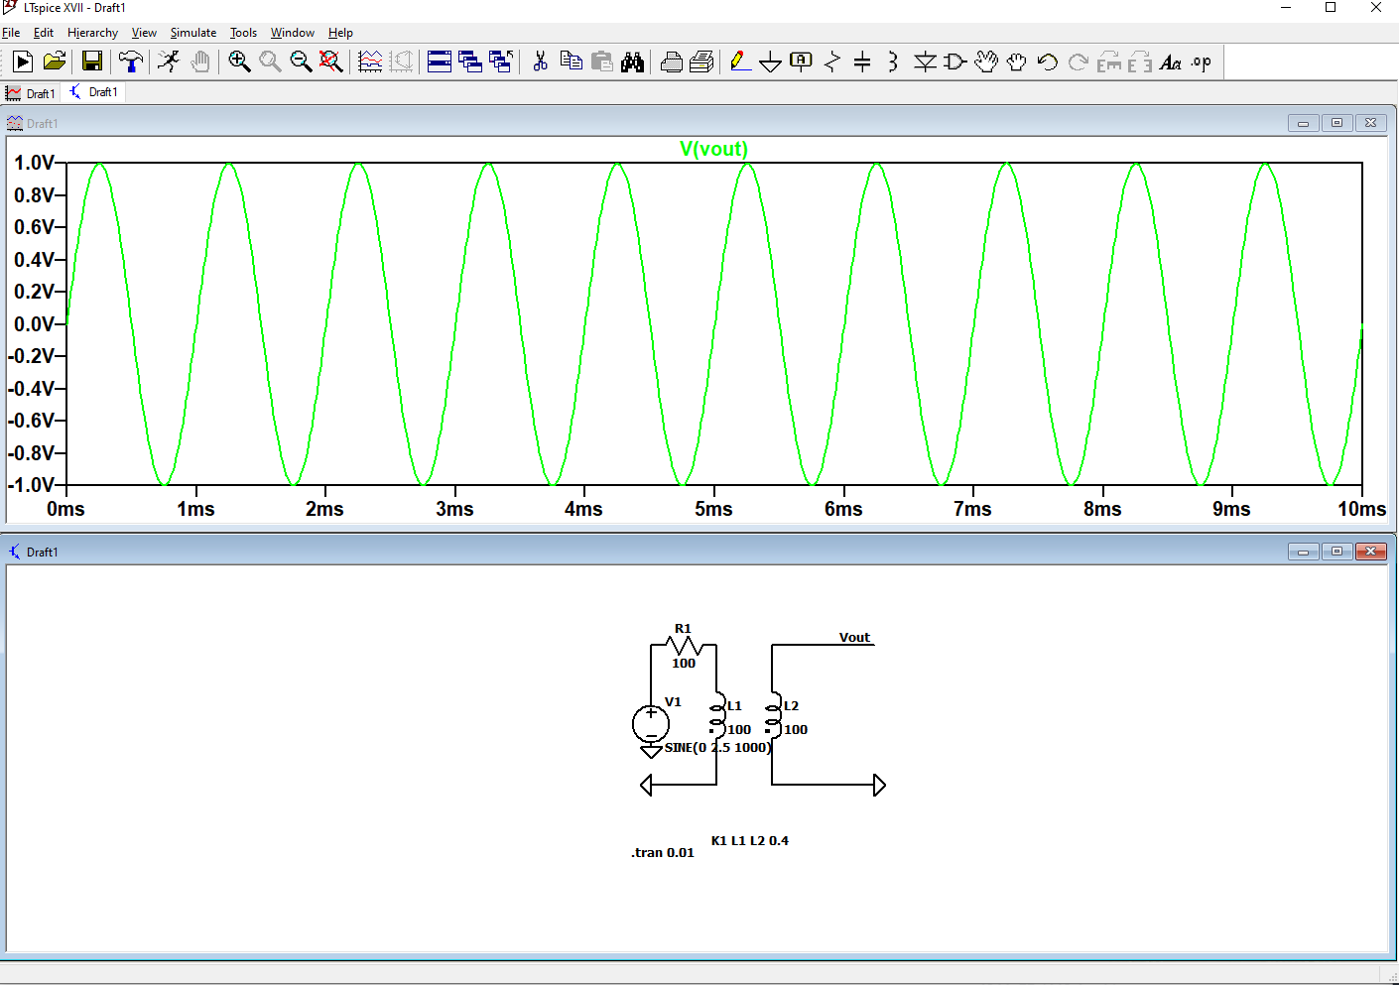
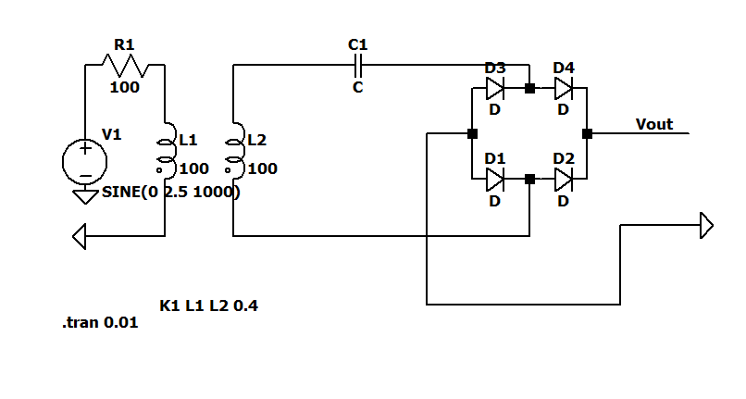
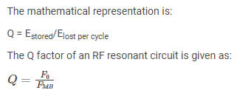
LTSpice Simulation
Simulation matched physical modeling with 0.4 Q factor

Slide 8
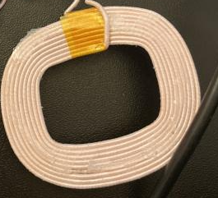

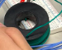
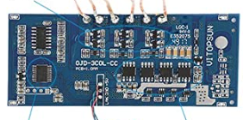
Test config
USB Power
A
Amazon
Qi
Charger Control Board
To establish charging contract
Charging sends a signal of 365 kHz.
Tx
Rx
B
Oscilloscope
Power connection
C
Oscilloscope
Power connection

Slide 9
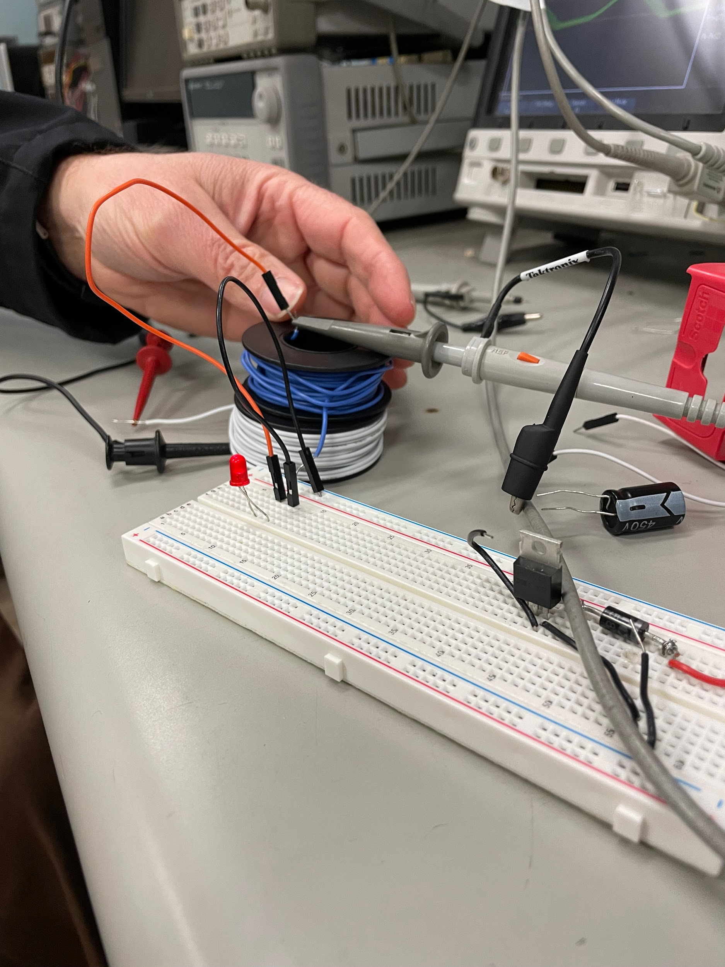
Testing Tx/Rx Diode Power Transfer
Function Generator
Input is 760 kHz, 5 Vpp
Coil Inductance is 193.7 uH
Tx White coil
Rx Blue coil
Output is 760 kHz, 1.1 Vpp
Coil Inductance is 90.4 uH
Oscilloscope

Slide 10
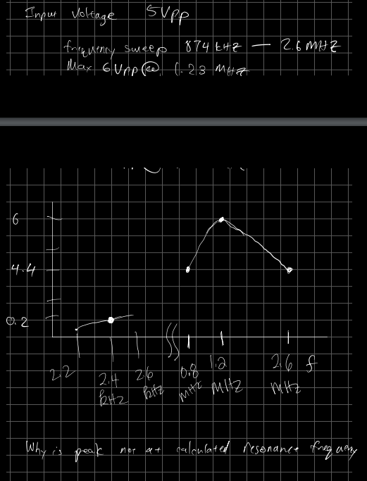
Testing Tx/Rx Diode Power Transfer
Function Generator
Input is 2.4 kHz, 5 Vpp
Coil Inductance is 192 uH
Tx White coil
Resonance frequency = 1/2pi *sqrt(LC) = 2.4 kHz
Output is 2.4 kHz, 0.2Vpp
Coil Inductance is 193 uH
Capacitor is 22 uF
Rx Greencoil
Max Received Voltage was 3 Vpp found to be at 1.2MHz not 2.3 kHz as expected.
Oscilloscope

Slide 11
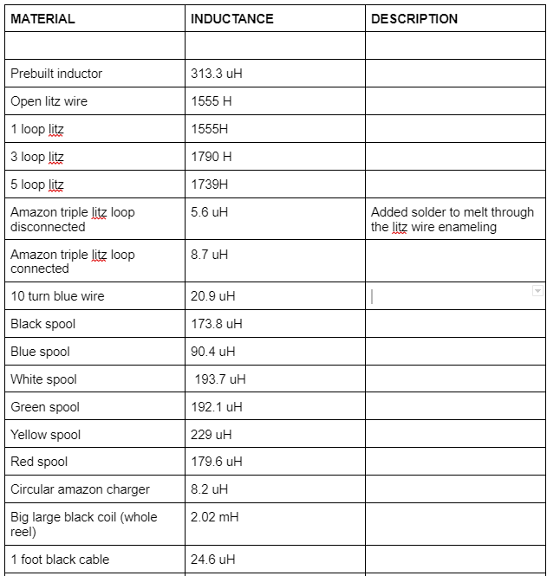
Materials
Two Copper Coils with Matching Inductance
4 diodes for rectifier
Signal Generator For Testing
Oscilloscope For Testing
Capacitor for imaginary impedance

Slide 12
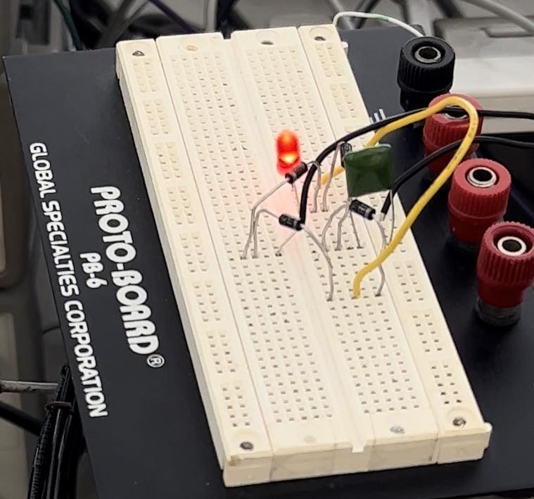
Design
Current circuit is just inductor through a rectifier with a capacitor in series for the imaginary impedance.
The main design is the wire loops that have to have the same impedance value.

Slide 13
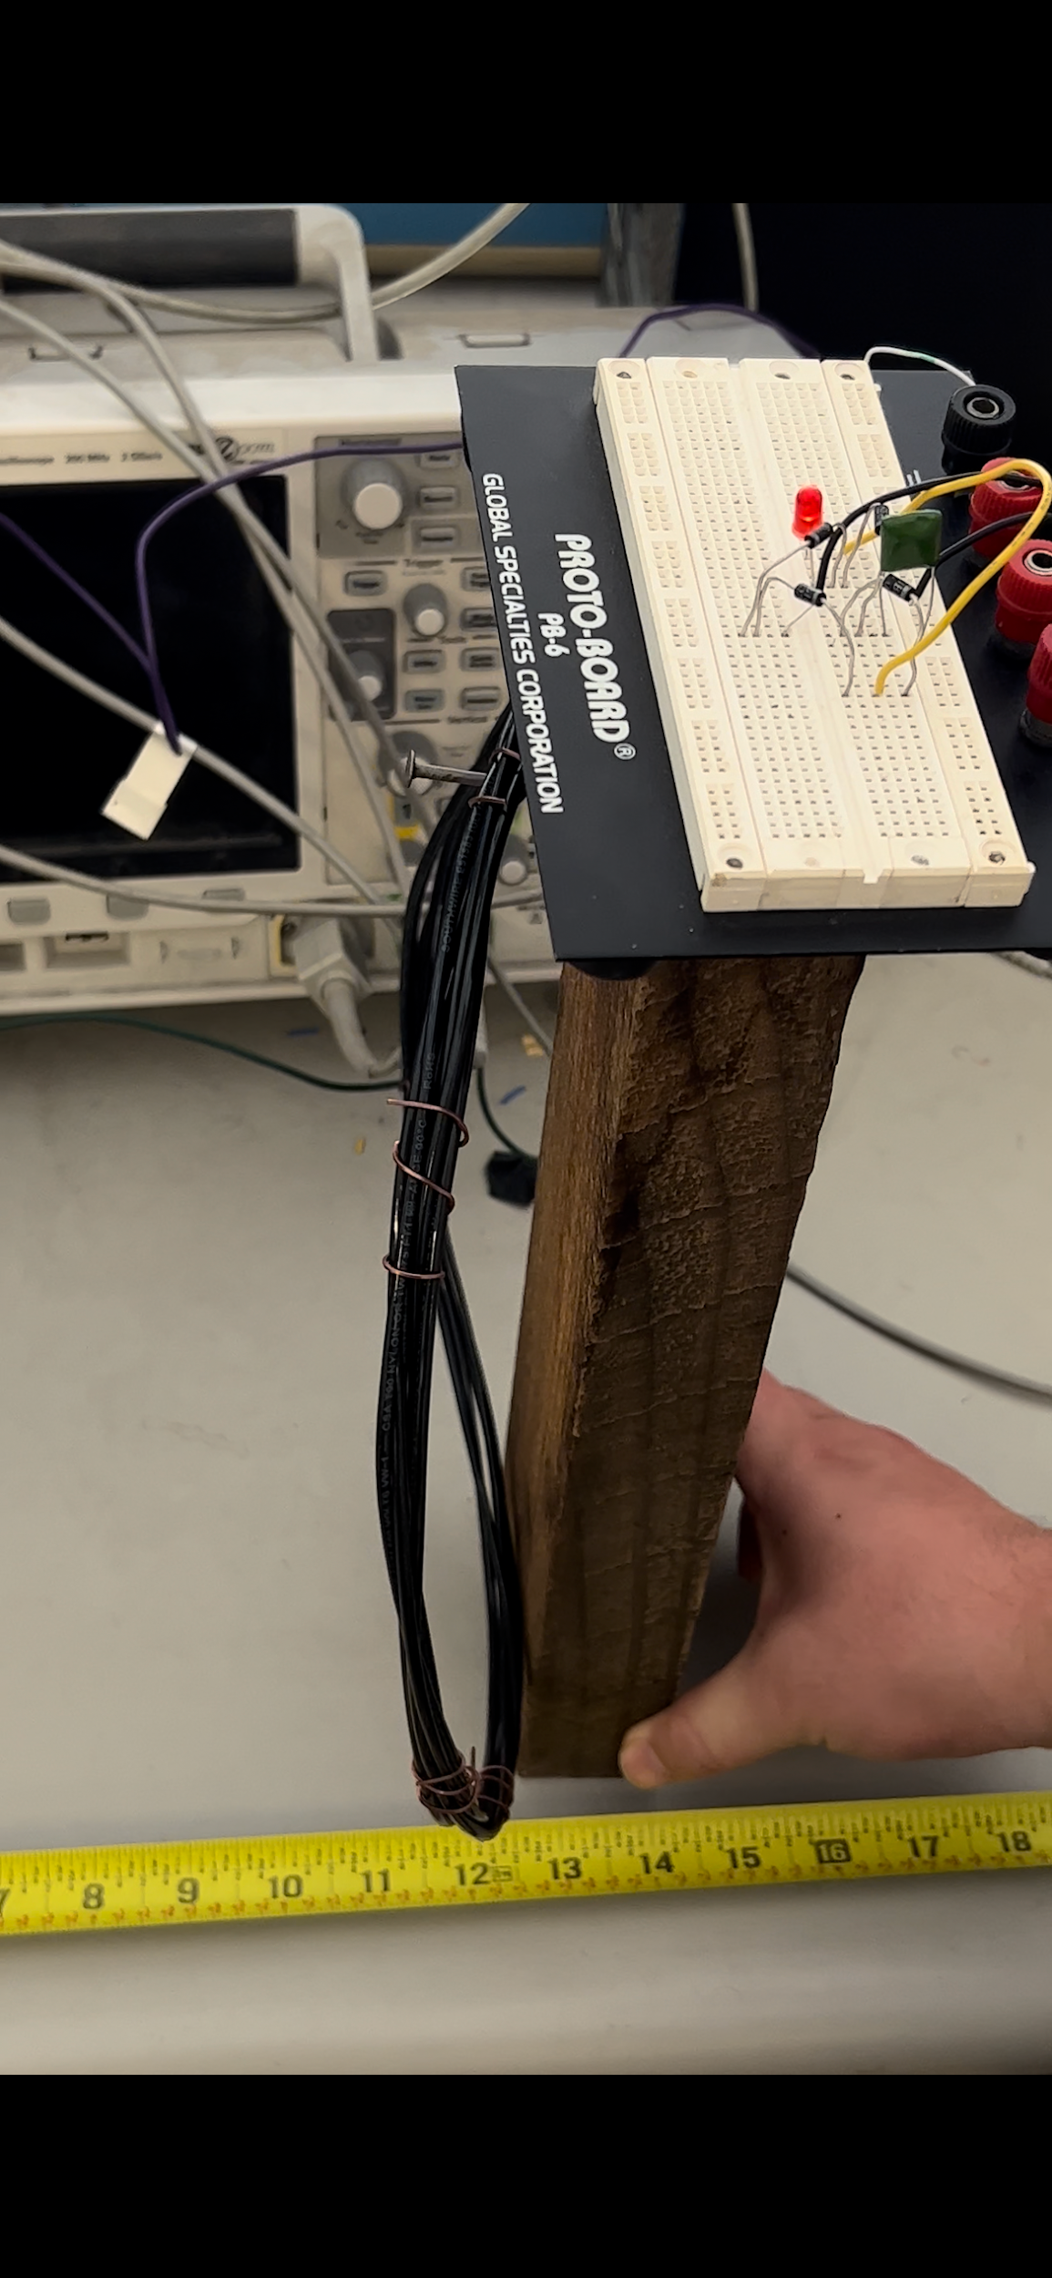
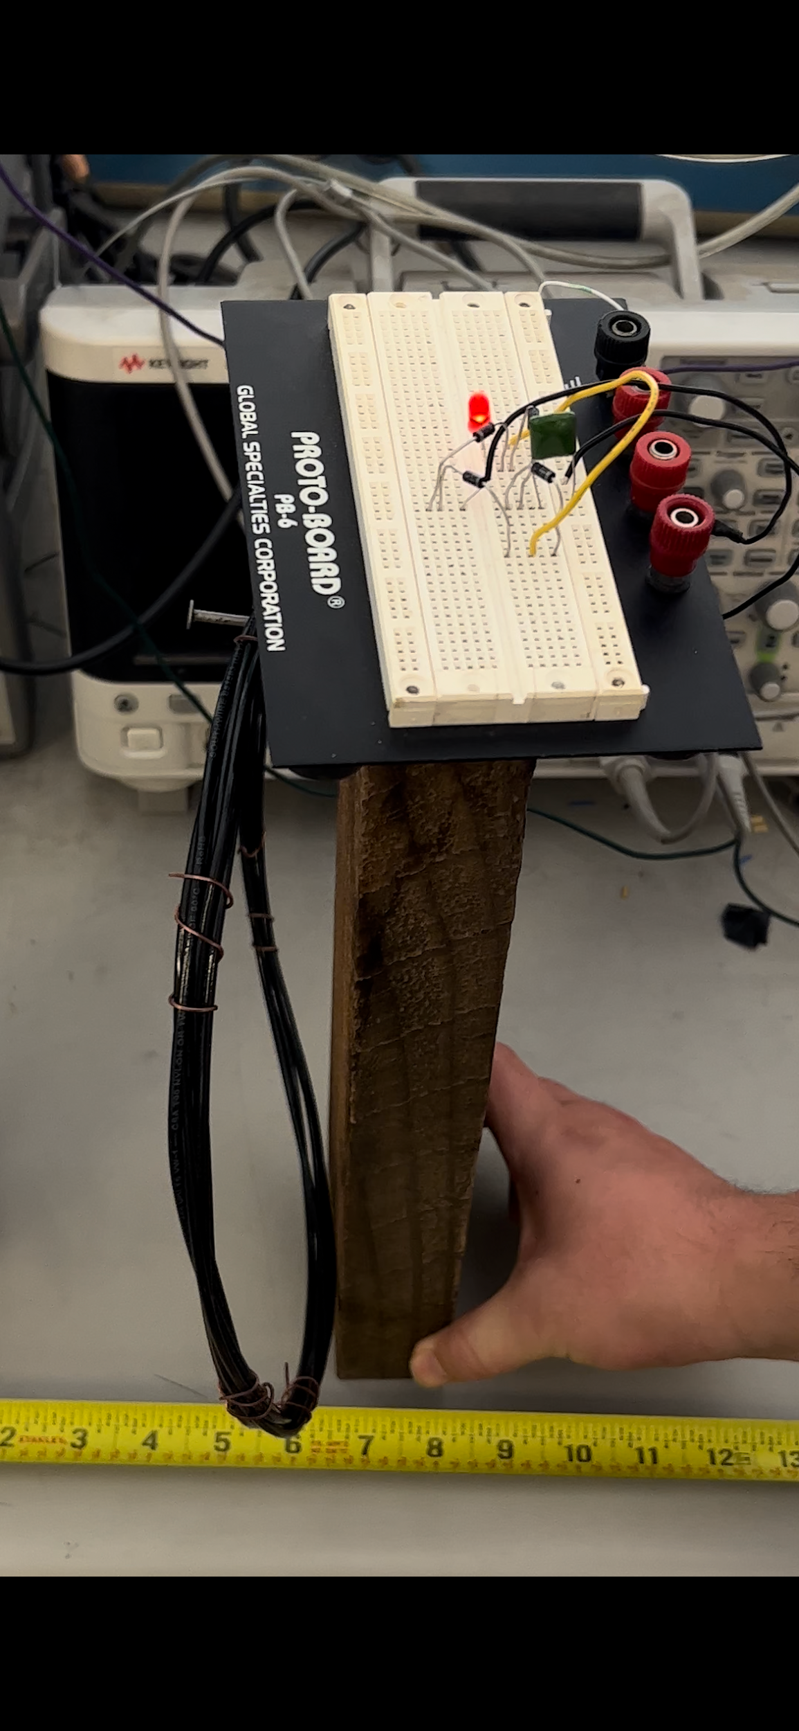
Testing
Input Conditions:
2.5 MHz Sine Wave
10 Vpp with 0.14A
Transmitted Power is 0.98W
At 12 inches away LED is dim but still on.
6 inches away LED is still at full brightness.
Transmission distance at 6 inches
Transmission distance at 12 inches

Slide 14
Results
Using a Sine Wave at 2.5 MHz with a 10Vpp transmitting 0.98W we can turn on an LED about 15 inches away.
7Vrms with 0.060A at maximum power transfer range (close together) gives 0.42W received power. The efficiency of this is about 43%.
After 6 inches there begins to be a drop off in voltage received and the LED becomes dimmer and dimmer the further it gets from the transmission coil. At 12 inches the received power is 2.5V with 0.020 A for 0.05W. The efficiency here is now 5% so there is significant drop off.

Slide 15
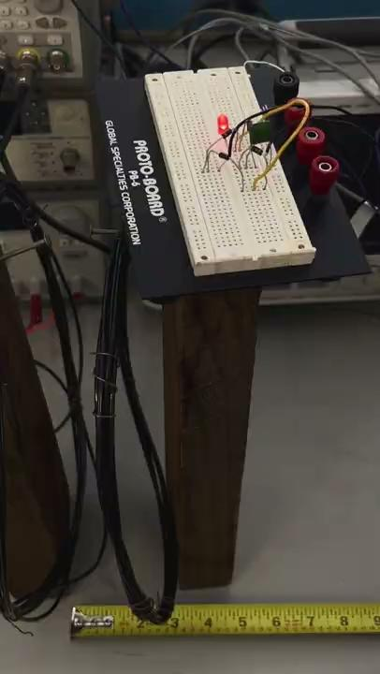

Slide 16
Conclusion / Future Work
After many design iterations and reading through the current Qi charging standard, it became apparent that a student making a Qi compliant charger is impossible because of the active data communication protocol, (DPSK modulation scheme) required to initiate the power transfer contract between Qi compliant devices.
Diving deep into the Wireless power transfer literature, we realized that resonance wireless charging is still considered “inductive resonance charging” due to the nature of sending and receiving magnetic B-fields to induce current in the receiver side inductor coil.
As for the results of our project, we were able to transmit 1W, which keeps the LED at full brightness, up until 6 inches and after the power received begins to diminish, and the LED turns off after 12 inches. We were able to see how power transfer is much more efficient with matching inductance values for the transmission and receiving coils rather than mismatched inducatances.

